Slide 1
Welcome to
This is where we live

Slide 2
Our village is very small.
There are 169 houses and 412 people live here.

Slide 3
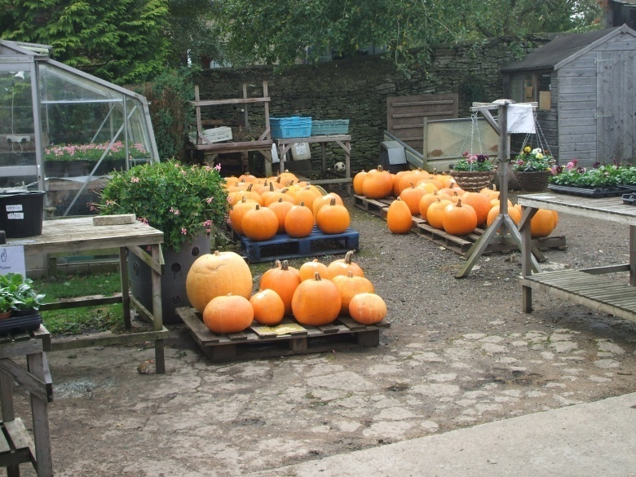
There are no shops in the village
There is a pub.
There is a coach company.
There is a yard that sells vegetables and plants.

Slide 4
The church is in the middle of the village.
On May Day there is a special parade to the church and then we have dancing at the pub called The Crown.

Slide 5
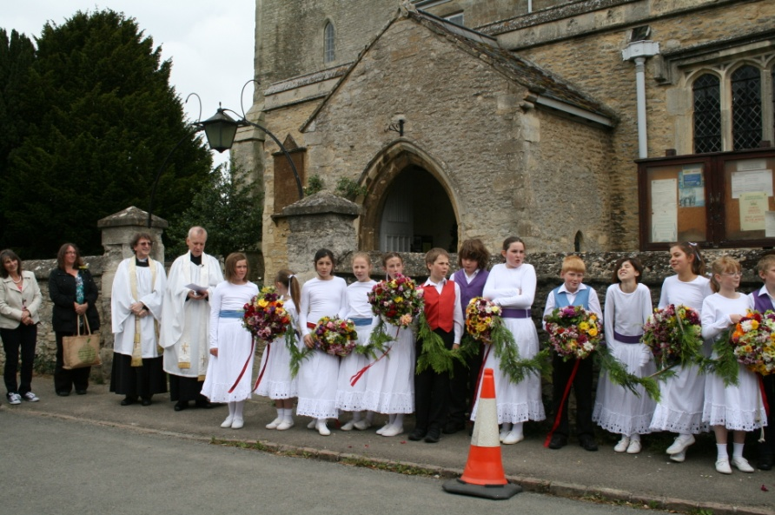
May Day

Slide 6
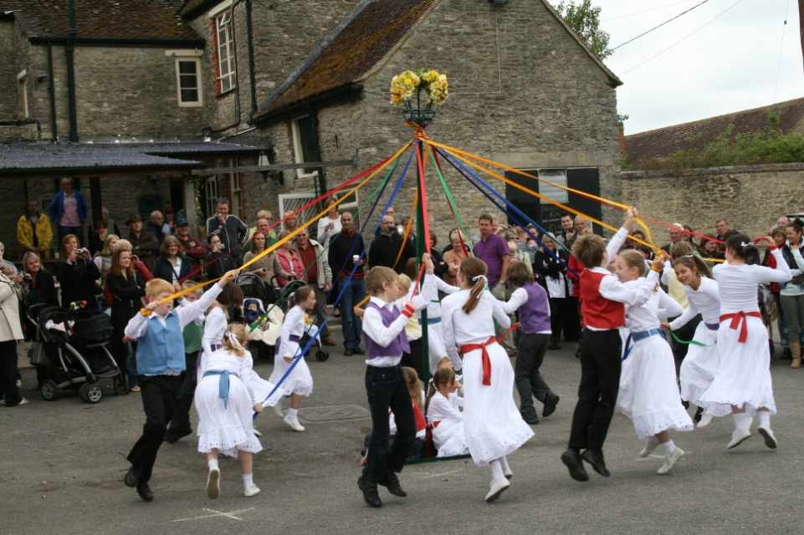
May Day

Slide 7
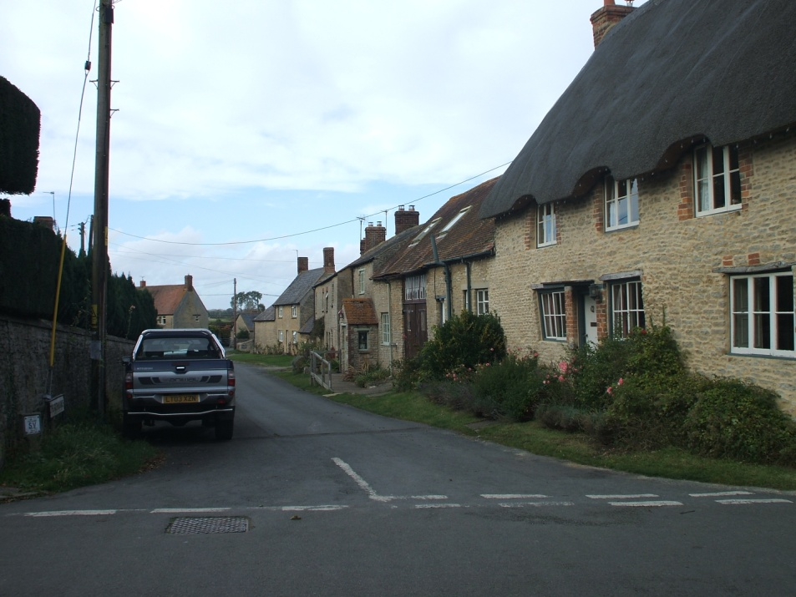
Many houses in the village are very old.

Slide 8
This is our school. It was built in 1866

Slide 9
The new part was built in 2010

Slide 10
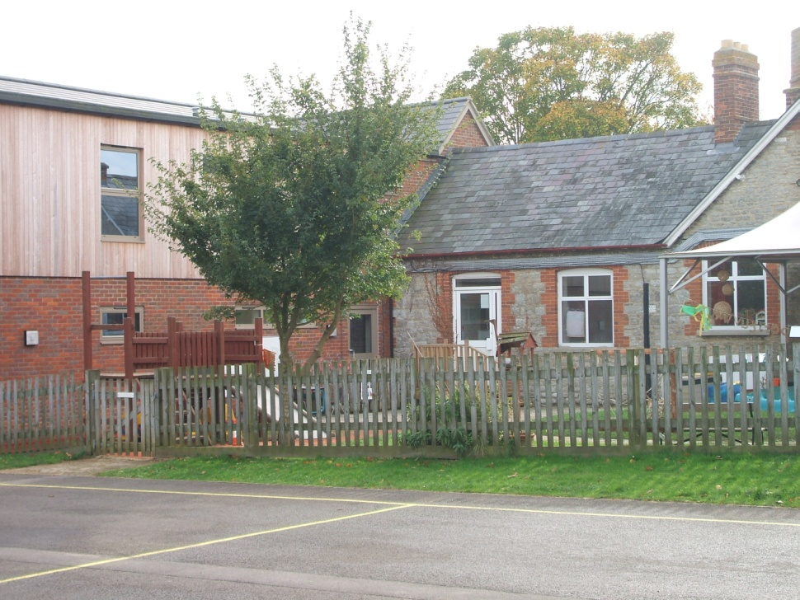
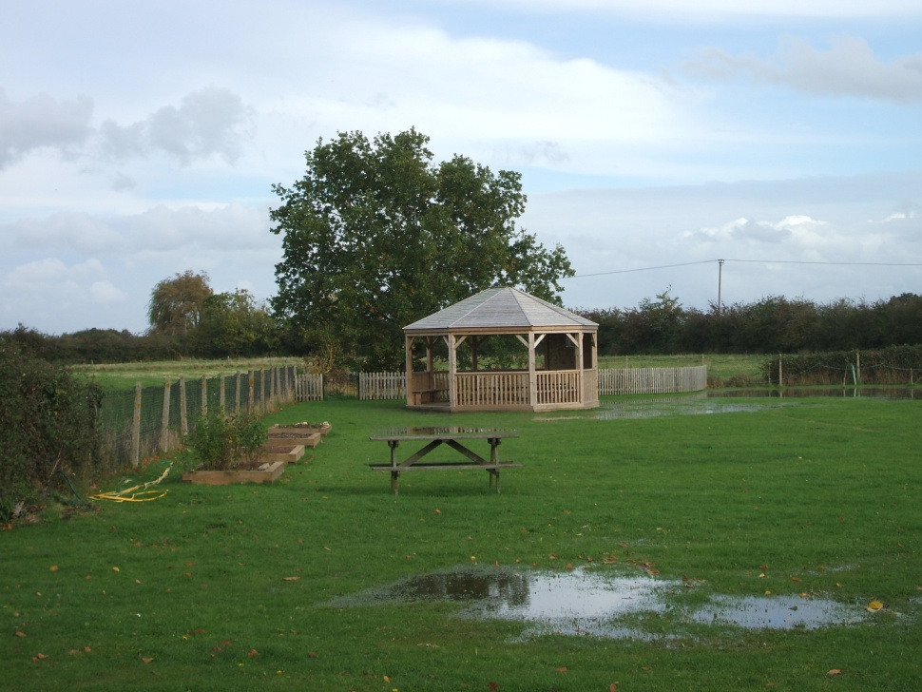
Around our school

Slide 11
Inside the school

Slide 12
Inside the school

Slide 13
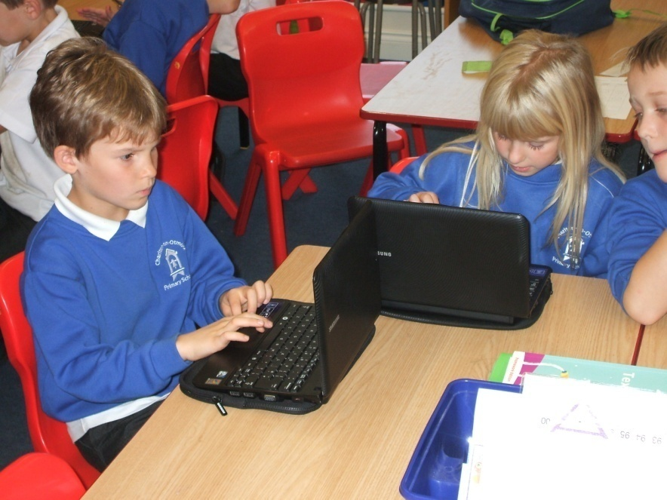
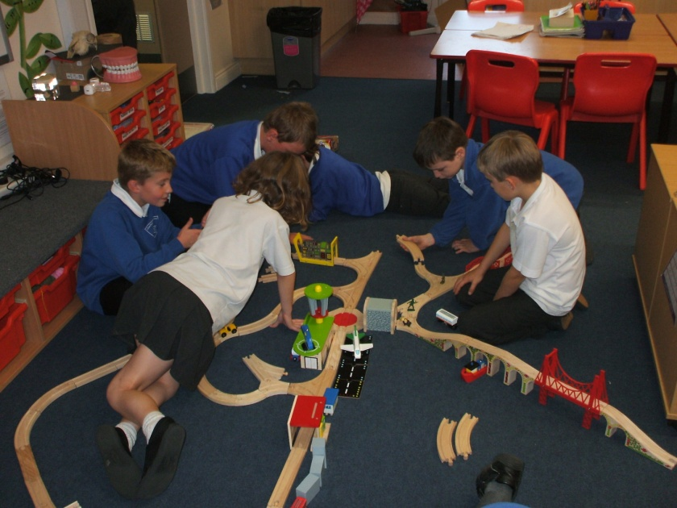
Inside our school

Slide 14
Sport

Slide 15
Sport

Slide 16
Bicester
Bicester is our nearest town.
It is about 4 miles(6.5km) from Charlton-on-Otmoor
It has a population of 30,000 but is the fastest growing town in Oxfordshire
It is an old market town and dates back to the 6th century
Market Square

Slide 17
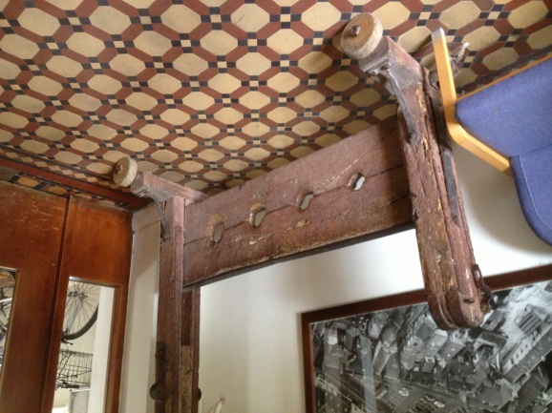
Bicester
Top: the Bandstand in Garth park Sheep Street is the main street in the town
Bottom: the stocks used to be in the Market Square

Slide 18
Bicester Village
Bicester Village is an outlet for designer clothes.
People come from many miles away (including other countries) to shop there
It is a very busy place

Slide 19
Our Christmas Production

